Slide 1

LMRFC Reference Slide For Crest Tables
LMRFC Forecasts Issued Morning of May 20, 2025
Lower Mississippi
RIVER FORECAST CENTER
Talking Points
Cairo, IL is forecast to crest at 35.0 ft on May 25. Following that long range outlooks show additional fluctuations, but below this level. The fluctuations are within seasonal ranges below flood stage and may postpone low flow for the next month or so.
Minor rises from this rise at Cairo, IL may make it to Memphis with some attenuation. Below that on the Middle and Lower Mississippi we anticipate a slowing of the current recession, but not a turnaround.
Stages on the Lower Mississippi River will remain elevated well into June.
We are also seeing falls on the Atchafalaya at Simmesport down to Morgan City. Other locations on the lower Boeuf and Tensas Rivers in the Backwater area are also showing slow falls now.
The “Comparative Mississippi River Crests” provide some context for similar magnitude historical floods relative to the current 2025 flood. Many factors play into the forecast that cause differences and every flood is a bit different.

Slide 2

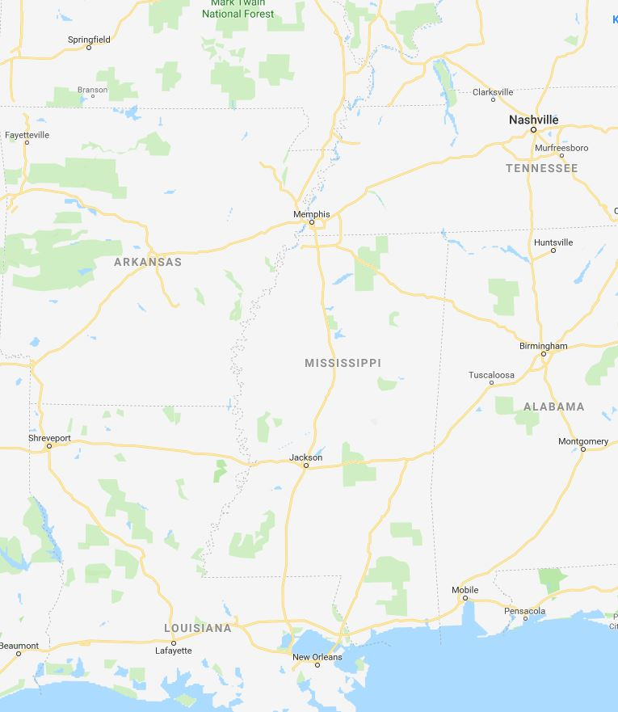



Crests and LMRFC forecasts produced morning of May 20, 2025
Ohio/Mississippi River Crest Watch
Lower Mississippi River Forecast Center weather.gov/lmrfc
@NWSLMRFC
X @NWSLMRFC
MS River at Caruthersville
OH River at Paducah
Current: 21.5’ Below F.S.
2 Days
Current: 25.1’ Below F.S.
Forecast:
Crested 26.4’
(Below F.S.) on May 10
Forecast:
Crested 27.5
(Below F.S.) on May 20
2 Days
½ Day
MS River at Memphis
OH River at Cairo
Current: 16.7’ Below F.S.
Current:31.3’ Action F.S.
Forecast:
Crested 19.6
(Below F.S.) on May 27
Forecast:
Crest 35.0
(Below F.S.) on May 25
MS River at Ark City
MS River at Greenville
Current: 27.7’ Below F.S.
4 Days
Crested 31.5’
(Below F.S.) on May 13
Current: 40.5’ Action F.S.
Forecast
Forecast:
Crested 44.2’
(Action F.S.) May 12
1 Day
1 Day
MS River at Natchez
MS River at Vicksburg
Current: 49.1’ Minor F.S.
Current: 40.4’ Action F.S.
Forecast:
Crested
Forecast:
Crested
2 Days
MS River at Baton Rouge
MS River at New Orleans
Current: 35.8’ Minor F.S.
1 Day
Current: 13.1’ Below F.S.
Forecast:
Forecast:
Slow fall with minor fluctuations
Crested
Travel Time for Crest

Slide 3
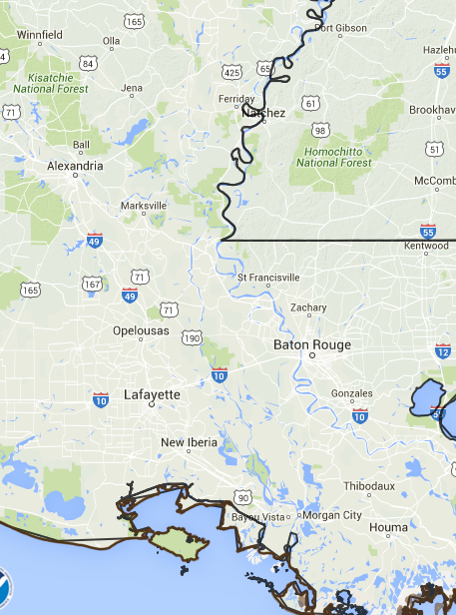
Atchafalaya River Crest Watch
Crests and LMRFC forecasts produced morning of May 20, 2025
Lower Mississippi River Forecast Center
@NWSLMRFC
X @NWSLMRFC
Black River at Jonesville
Backwater
Current: 44.7’ (Below F.S.)
Forecast:
Crested at 47.5’
(Below F.S.) May 10
Black River at Acme
Current: 40.4’ Estimated
(Below F.S.)
Forecast:
Crested at 44.0’
(Below F.S.) May 1
Atchafalaya River at Simmesport
Falling
Current: 32.4’ (Below F.S.)
Forecast:
Crested at 38.2’
(Action F.S.) May 1
Atchafalaya River at Melville
Current: 26.0’ (Below F.S.)
0.25 Day
Forecast:
Crested at 30.2’ (Below F.S.) May 1
0.25 Day
Atchafalaya River at Krotz Springs
Current: 23.4’ (Below F.S.)
Atchafalaya River at Bayou Sorrel
Forecast:
Crested at 27.0’
(Below F.S.) May 1
0.5 Day
Current: 10.2’ (Below F.S.)
0.5 Day
Crested at 11.2’
(Action F.S.) May 8
Forecast:
Atchafalaya River at Butte La Rose
Rising
Current: 17.5’ (Action F.S.)
Atchafalaya River at Morgan City
Forecast:
Crested at 19.3’
(Action F.S.) May 2
1 Day
Current: 6.2’ (Minor F.S.)
Rising
Forecast:
Cresting at 6.8’
(Minor F.S.) May 8
Backwater - Water moving upstream from Old River Control Structure
Old River Control Structure

Slide 4
Data provided by U.S. Army Corps of Engineers
Comparative Mississippi River Crests
Lower Mississippi River Forecast Center
Current data as of May 20, 2025
Forecast Location | 2025 | 2005 | 2009 | 2017
Cairo, IL | 52.6 (crest) | 53.2 | 51.1 | 52.2
Memphis, TN | 37.6 (crest) | 35.7 | 34.7 | 36.0
Arkansas City, AR | 42.4 (crest) | 39.3 | 40.4 | 42.1
Greenville, MS | 54.6 (crest) | 50.7 | 52.9 | 54.3
Vicksburg, MS | 49.4 (crest) | 44.5 | 47.6 | 48.3
Natchez, MS | 55.8 (crest) | 51.2 | 54.4 | 54.9
Red River Landing, LA | 59.5 (crest) | 55.1 | 58.1 | 57.7
Baton Rouge, LA | 42.3 (crest) | 38.5 | 40.8 | 40.6
New Orleans, LA | 16.7 (crest) | 16.3 | 16.5 | 16.5

